Slide 1





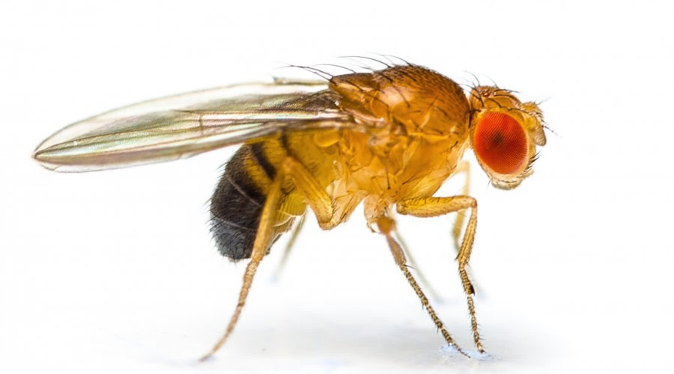
M2R – Écologie Évolution
2018-2019
Mate copying in flies: a matter of DESIRE or disgust ?
Guillaume Lespagnol
Supervisors: Guillaume Isabel and Magdalena Monier

Slide 2
Introduction
Materials & methods
Discussion
Results
2
Animal culture?

Slide 3
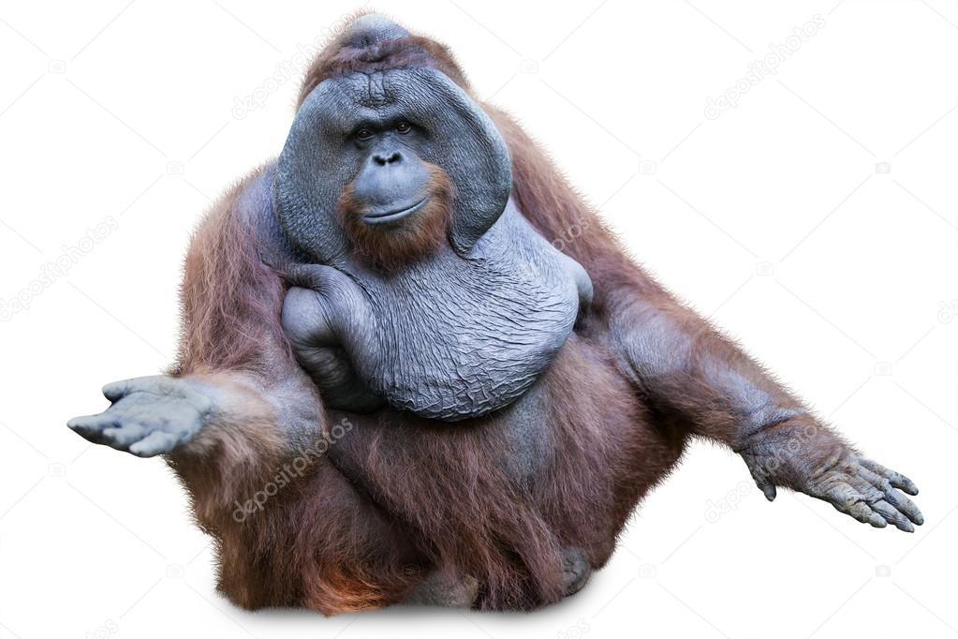
Introduction
Materials & methods
Discussion
Results
3
Animal culture?
In primates
van Schaik et al., 2003

Slide 4

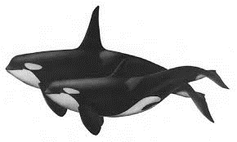
Introduction
Materials & methods
Discussion
Results
4
Animal culture?
In primates
In mammals
Whitehead et al., 2017
Thornton et al., 2010

Slide 5

Introduction
Materials & methods
Discussion
Results
5
Animal culture?
In primates
In mammals
In Drosophila melanogaster!
Danchin et al., 2018

Slide 6
Introduction
Materials & methods
Discussion
Results
6
Animal culture?
In primates
In mammals
In Drosophila melanogaster!
Cultural transmission of mate choice
Mating matters

Slide 7
Introduction
Materials & methods
Discussion
Results
7
Mating matters
Mate choice is crucial for fitness

Slide 8
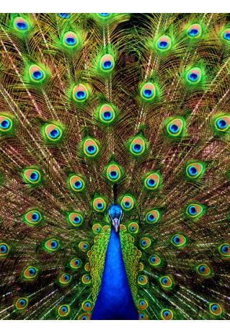
Introduction
Materials & methods
Discussion
Results
8
Mating matters
Mate choice is crucial for fitness
→ Highly conspicuous traits

Slide 9
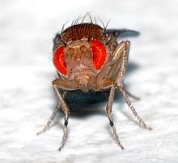
Introduction
Materials & methods
Discussion
Results
9
Mating matters
Mate choice is crucial for fitness
→ Highly conspicuous traits
But not a rule
→ Mate choice arises from
numerous factors

Slide 10
Introduction
Materials & methods
Discussion
Results
10
Mating matters
Mate choice is crucial for fitness
→ Highly conspicuous traits
But not a rule
→ Mate choice arises from
numerous factors
Choice of conspecifics
→ Mate copying

Slide 11
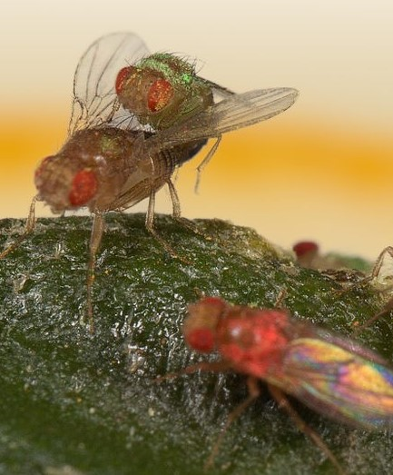
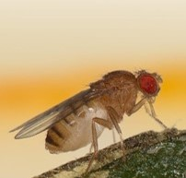
Introduction
Materials & methods
Discussion
Results
11
Mate copying
→ Observation of a sexual interaction biases subsequent mate choice
Accepted male
Information
Observer
Rejected male
Demonstrators

Slide 12
Introduction
Materials & methods
Discussion
Results
12
Mate copying
→ Observation of a sexual interaction biases subsequent mate choice
Accepted male
Information
. . .
Observer
Rejected male
Demonstrators

Slide 13
Introduction
Materials & methods
Discussion
Results
13
Mate copying
→ Observation of a sexual interaction biases subsequent mate choice
Accepted male
Information
. . .
Observer
Rejected male
Demonstrators
Indirect (social) learning

Slide 14
Introduction
Materials & methods
Discussion
Results
14
Mate copying ?
→ Arises from appetitive or aversive memory ?
Accepted male
Positive Information
Rejected male

Slide 15
Introduction
Materials & methods
Discussion
Results
15
Mate copying ?
→ Arises from appetitive or aversive memory ?
Accepted male
Positive Information
Negative Information
Rejected male

Slide 16
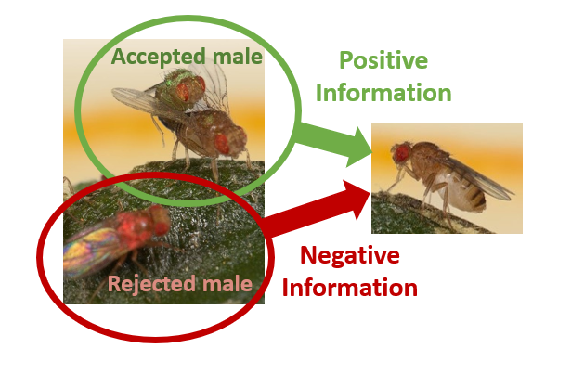
Introduction
Materials & methods
Discussion
Results
16
Mate copying:
I.
Does mate copying arise from appetitive or aversive memory ?

Slide 17
Introduction
Materials & Methods
Discussion
Results
17
I. Does mate copying arise from appetitive or aversive memory ?
Acceptance / Rejection experiment: 3 treatments
Control Acceptance Rejection

Slide 18
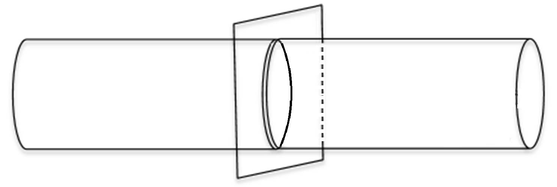
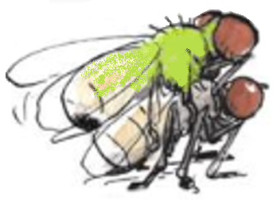
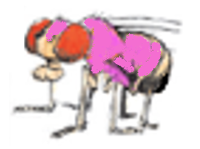
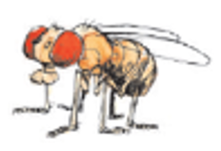

Introduction
Materials & Methods
Discussion
Results
18
I. Does mate copying arise from appetitive or aversive memory ?
Acceptance / Rejection experiment: 3 treatments
Control Acceptance Rejection
1st
Demo
2nd Demo
Test

Slide 19
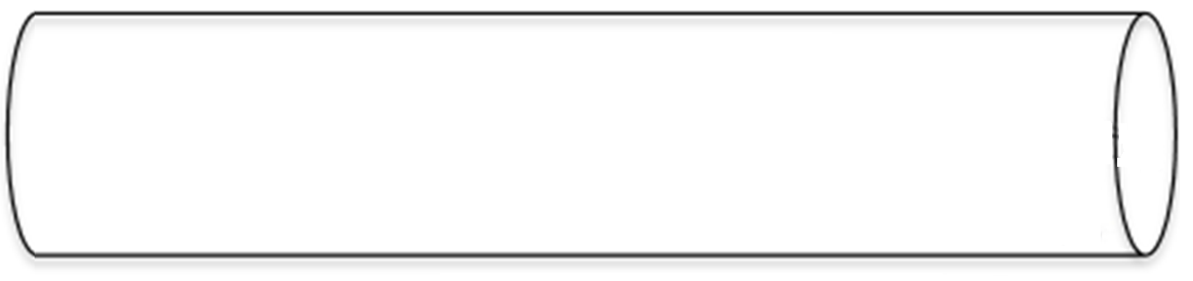
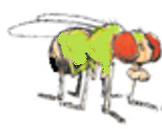
Introduction
Materials & Methods
Discussion
Results
19
I. Does mate copying arise from appetitive or aversive memory ?
Acceptance / Rejection experiment: 3 treatments
Control Acceptance Rejection
1st
Demo
2nd Demo
Test

Slide 20
Introduction
Materials & Methods
Discussion
Results
20
I. Does mate copying arise from appetitive or aversive memory ?
Acceptance / Rejection experiment: 3 treatments
Control Acceptance Rejection
1st
Demo
2nd Demo
Test

Slide 21
Introduction
Materials & Methods
Discussion
Results
21
I. Does mate copying arise from appetitive or aversive memory ?
Acceptance / Rejection experiment: 3 treatments
Control Acceptance Rejection
1st
Demo
2nd Demo
Test

Slide 22
Introduction
Materials & Methods
Discussion
Results
22
I. Does mate copying arise from appetitive or aversive memory ?
Acceptance / Rejection experiment: 3 treatments
Control Acceptance Rejection
1st
Demo
2nd Demo
Test

Slide 23
Introduction
Materials & Methods
Discussion
Results
23
I. Does mate copying arise from appetitive or aversive memory ?
Acceptance / Rejection experiment: 3 treatments
Control Acceptance Rejection
1st
Demo
2nd Demo
Test
Mate-copying score
Mate-copying score
Mate-copying score

Slide 24
Introduction
Materials & Methods
Discussion
Results
24
Statistical analysis
Mate copying score:
1
If the color of the chosen male is the one accepted during demonstration
(mcs)
0
If the color of the chosen male is the one rejected during demonstration

Slide 25
Introduction
Materials & Methods
Discussion
Results
25
Statistical analysis
Mate copying score:
1
If the color of the chosen male is the one accepted during demonstration
(mcs)
0
If the color of the chosen male is the one rejected during demonstration
Mate copying index = Mean of mcs per treatment
(mci)

Slide 26
Introduction
Materials & Methods
Discussion
Results
26
Statistical analysis
Mate copying score:
1
If the color of the chosen male is the one accepted during demonstration
(mcs)
0
If the color of the chosen male is the one rejected during demonstration
Mate copying index = Mean of mcs per treatment
(mci)
1. Binomial test: Test difference from random choice for each treatment

Slide 27
Introduction
Materials & Methods
Discussion
Results
27
Statistical analysis
Mate copying score:
1
If the color of the chosen male is the one accepted during demonstration
(mcs)
0
If the color of the chosen male is the one rejected during demonstration
Mate copying index = Mean of mcs per treatment
(mci)
1. Binomial test: Test difference from random choice for each treatment
2. GLMM : Test effect of variables on mate copying score
mcs ~ treatment
Mate copying score
~
- Treatment

Slide 28
Introduction
Materials & Methods
Discussion
Results
28
Statistical analysis
Mate copying score:
1
If the color of the chosen male is the one accepted during demonstration
(mcs)
0
If the color of the chosen male is the one rejected during demonstration
Mate copying index = Mean of mcs per treatment
(mci)
1. Binomial test: Test difference from random choice for each treatment
2. GLMM : Test effect of variables on mate copying score
mcs ~ treatment + nAP0+ nAPC+ treatment * nAP0 * nAPC +(1|block)
Mate copying score
~
- Treatment - Air pressure
- Air pressure variation
Dagaeff et al., 2016

Slide 29
Introduction
Materials & Methods
Discussion
Results
29
Statistical analysis
Mate copying score:
1
If the color of the chosen male is the one accepted during demonstration
(mcs)
0
If the color of the chosen male is the one rejected during demonstration
Mate copying index = Mean of mcs per treatment
(mci)
1. Binomial test: Test difference from random choice for each treatment
2. GLMM: Test effect of variables on mate copying score
mcs ~ treatment + nAP0+ nAPC+ treatment * nAP0 * nAPC +(1|block)
3. Post-hoc tests: Comparisons between treatments were done using post-hoc X² tests

Slide 30
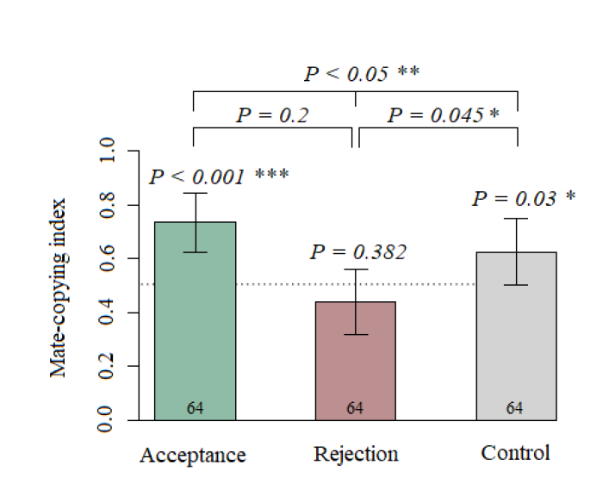
Introduction
Materials & Methods
Discussion
Results
30
I. Does mate copying arise from appetitive or aversive memory ?
Acceptance / Rejection experiment:
Mate copying index of Acceptance treatment is different from random, mate index score of Rejection is not
1. Binomial test
2. GLMM
3. Post-hoc tests
N=
N=
N=

Slide 31
Introduction
Materials & Methods
Discussion
Results
31
I. Does mate copying arise from appetitive or aversive memory ?
Acceptance / Rejection experiment:
Only the treatment has a significant effect on mate copying score:
χ² = 10.447
P = 0.005
1. Binomial test
2. GLMM
3. Post hoc tests
N=
N=
N=

Slide 32
Introduction
Materials & Methods
Discussion
Results
32
I. Does mate copying arise from appetitive or aversive memory ?
Acceptance / Rejection experiment:
Acceptance-Rejection (χ² = 11.62, P < 0.005)
Control-Rejection (χ² = 4.52, P = 0.033)
Acceptance-Control (² = 1.76, P = 0.18)
P = 0.18
1. Binomial test
2. GLMM
3. Post-hoc tests
N=
N=
N=

Slide 33
Introduction
Materials & Methods
Discussion
Results
33
I. Observation of acceptance is required for mate copying, not rejection
Mate copying arise from positive information and appetitive memory

Slide 34
Introduction
Materials & Methods
Discussion
Results
34
I. Observation of acceptance is required for mate copying, not rejection
Mate copying arise from positive information and appetitive memory
Appetitive indirect (social) learning

Slide 35
Introduction
Materials & Methods
Discussion
Results
35
I. Observation of acceptance is required for mate copying, not rejection
Mate copying arise from positive information and appetitive memory
Indirect learning (social)
Learning
Information

Slide 36
Introduction
Materials & Methods
Discussion
Results
36
I. Observation of acceptance is required for mate copying, not rejection
Mate copying arise from positive information and appetitive memory
Indirect learning (social)
Learning
Information
Direct learning (non social)
Learning

Slide 37

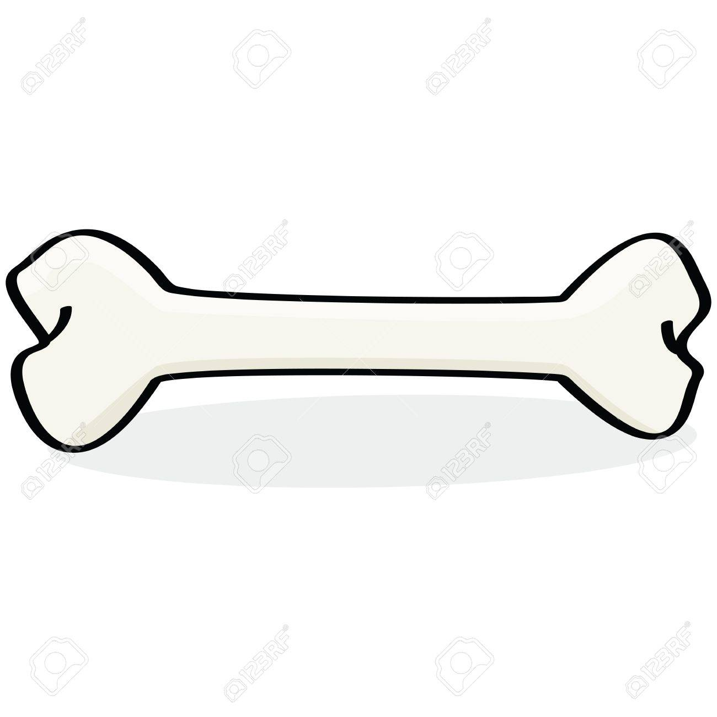
Introduction
Materials & methods
Discussion
Results
37
Direct learning mechanisms
Associative learning
Conditional
Unconditional

Slide 38
Introduction
Materials & methods
Discussion
Results
38
Direct learning mechanisms
Associative learning
Conditional
Unconditional
Mate copying
Learning
Conditional
Unconditional
Avargués et al.,2015

Slide 39
Introduction
Materials & methods
Discussion
Results
39
Direct learning
Appetitive learning
Conditional
Positive

Slide 40
Introduction
Materials & methods
Discussion
Results
40
Direct learning
Appetitive learning
Conditional
Positive
Aversive learning
Conditional
Negative

Slide 41
Introduction
Materials & methods
Discussion
Results
41
Direct learning
Appetitive learning
Conditional
Positive
Aversive learning
Conditional
Negative
DIFFERENT NEURONS
Vogt et al., 2016

Slide 42
Introduction
Materials & methods
Discussion
Results
42
Visual direct learning
Ddc-labbeled neurons TH-labbeled neurons
(Dopamine-decarboxylase) (Tyrosine hydroxylase)
Vogt et al., 2016

Slide 43
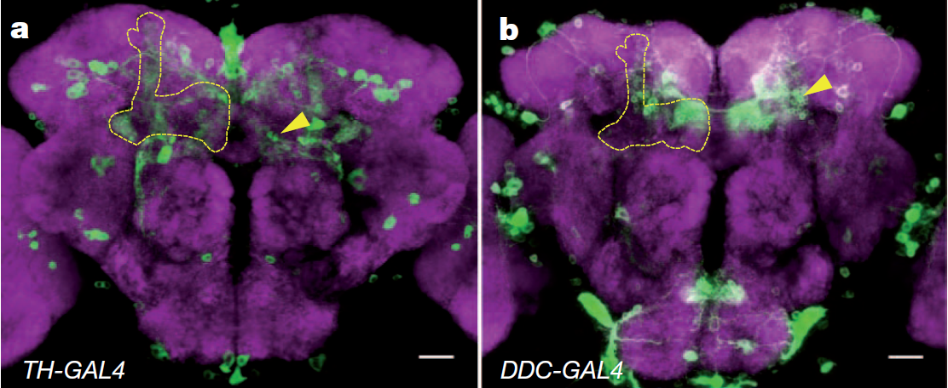
Introduction
Materials & methods
Discussion
Results
43
Visual direct learning
Ddc-labbeled neurons TH-labbeled neurons
(Dopamine-decarboxylase) (Tyrosine hydroxylase)
Liu et al., 2012

Slide 44
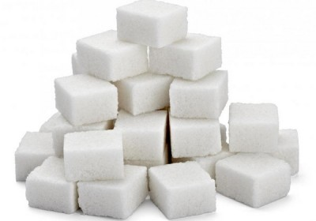
Introduction
Materials & methods
Discussion
Results
44
Visual direct learning
Ddc-labbeled neurons TH-labbeled neurons
(Dopamine-decarboxylase) (Tyrosine hydroxylase)
Appetitive visual direct learning
Aversive visual
direct learning
Vogt et al., 2016

Slide 45
Introduction
Materials & methods
Discussion
Results
45
Mate copying ?
Appetitive visual indirect learning

Slide 46
Introduction
Materials & methods
Discussion
Results
46
Mate copying ?
Appetitive visual indirect learning
→ Which groups of neurons involved ?

Slide 47
Introduction
Materials & methods
Discussion
Results
47
Mate copying ?
Appetitive visual indirect learning
→ Which groups of neurons involved ?
Direct learning
Mate copying
But: - Similar learning mechanisms
- Common neurotransmitter (Dopamine)
Monier et al., 2018

Slide 48
Introduction
Materials & methods
Discussion
Results
48
Mate copying ?
Appetitive visual indirect learning
→ Which groups of neurons involved ?
Direct learning
Mate copying
But: - Similar learning mechanisms
- Common neurotransmitter (Dopamine)
COMMON GROUP OF NEURONS ? DDC?

Slide 49
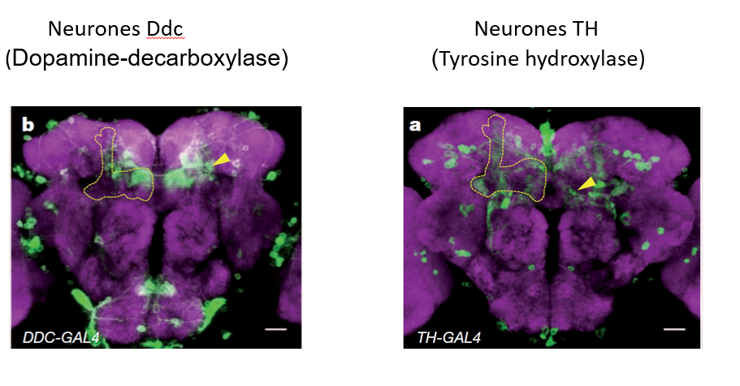
Introduction
Materials & methods
Discussion
Results
49
Mate copying: Two questions
I
Does mate copying arise from appetitive or aversive memory ?
II
Are TH and Ddc neurons involved ?

Slide 50
Introduction
Materials & Methods
Discussion
Results
50
II. Are TH and Ddc neurons involved in mate copying?
Neuronal blockade experiment
Demonstration:
Test:
Mate copying score

Slide 51
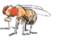
Introduction
Materials & Methods
Discussion
Results
51
II. Are TH and Ddc neurons involved in mate copying?
Neuronal blockade experiment
Mutant flies: UAS/GAL4
- Treatment 1: Ddc-GAL4/ UAS-Shits
- Treatment 2: TH-GAL4/ UAS-Shits
Demonstration:
Test:
Mate copying score

Slide 52
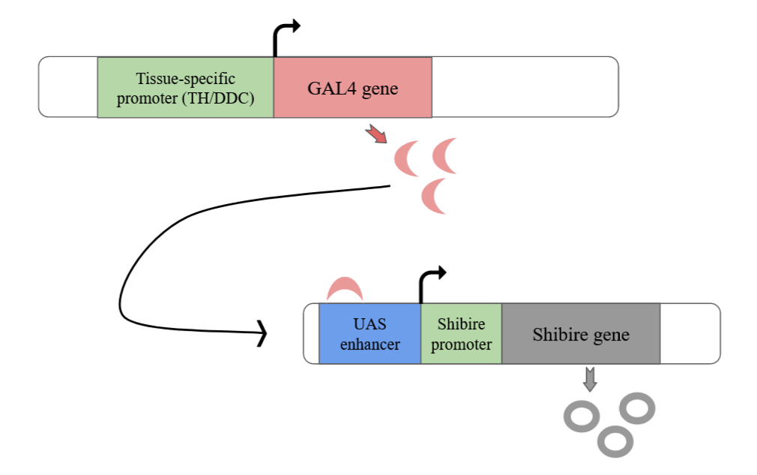
Introduction
Materials & Methods
Discussion
Results
52
II. Are TH and Ddc neurons involved in mate copying?
UAS/GAL4:

Slide 53
Introduction
Materials & Methods
Discussion
Results
53
II. Are TH and Ddc neurons involved in mate copying?
UAS/GAL4:

Slide 54
Introduction
Materials & Methods
Discussion
Results
54
II. Are TH and Ddc neurons involved in mate copying?
UAS/GAL4:
Block neuronal activity at 33°C

Slide 55
Introduction
Materials & Methods
Discussion
Results
55
II. Are TH and Ddc neurons involved in mate copying?
Neuronal blockade experiment
Mutant flies:
- Treatment 1: Ddc-GAL4/ UAS-Shits
- Treatment 2: TH-GAL4/ UAS-Shits
Demonstration:
Test:
Mate copying score

Slide 56
Introduction
Materials & Methods
Discussion
Results
56
II. Are TH and Ddc neurons involved in mate copying?
Neuronal blockade experiment
Mutant flies:
- Treatment 1: Ddc-GAL4/ UAS-Shits
- Treatment 2: TH-GAL4/ UAS-Shits
Demonstration:
33°C
Test:
Mate copying score
Block neuronal activity at 33°C

Slide 57
Introduction
Materials & Methods
Discussion
Results
57
II. Are TH and Ddc neurons involved in mate copying?
Neuronal blockade experiment
Mutant flies:
- Treatment 1: Ddc-GAL4/ UAS-Shits
- Treatment 2: TH-GAL4/ UAS-Shits
Demonstration:
33°C
Test:
Mate copying score
If one group is involved,
the corresponding treatment will not display mate copying
Block neuronal activity at 33°C

Slide 58
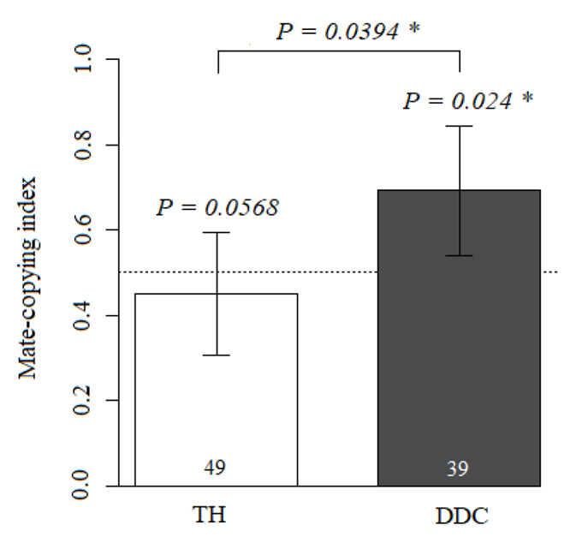
Introduction
Materials & Methods
Discussion
Results
58
II. Are TH and Ddc neurons involved in mate copying?
Neuronal blockade experiment:
Mate copying index of Ddc treatment is different from random
1. Binomial test
2. GLMM
N=
N=
Ddc-GAL4
UAS-Shi^{ts}

Slide 59
Introduction
Materials & Methods
Discussion
Results
59
II. Are TH and Ddc neurons involved in mate copying?
Neuronal blockade experiment:
Mate copying index of Ddc treatment is different from random
1. Binomial test
2. GLMM
Neurons of appetitive direct learning are not involved in mate-copying
N=
N=
Ddc-GAL4
UAS-Shi^{ts}

Slide 60
Introduction
Materials & Methods
Discussion
Results
60
II. Are TH and Ddc neurons involved in mate copying?
Neuronal blockade experiment:
Mate copying index of Ddc treatment is different from random
Mate copying index of TH treatment is not
1. Binomial test
2. GLMM
N=
N=
TH-GAL4
UAS-Shi^{ts}
Ddc-GAL4
UAS-Shi^{ts}

Slide 61
Introduction
Materials & Methods
Discussion
Results
61
II. Are TH and Ddc neurons involved in mate copying?
Neuronal blockade experiment:
Mate copying index of Ddc treatment is different from random
Mate copying index of TH treatment is not
1. Binomial test
2. GLMM
Neurons of aversive direct learning are involved in mate-copying
Appetitive indirect learning
N=
N=
TH-GAL4
UAS-Shi^{ts}
Ddc-GAL4
UAS-Shi^{ts}

Slide 62
Introduction
Materials & Methods
Discussion
Results
62
II. Are TH and Ddc neurons involved in mate copying?
Neuronal blockade experiment:
Only the treatment has a significant effect on mate copying score:
χ² = 4.245
P = 0.0394
1. Binomial test
2. GLMM
N=
N=
TH-GAL4
UAS-Shi^{ts}
Ddc-GAL4
UAS-Shi^{ts}

Slide 63
Introduction
Materials & Methods
Discussion
Results
63
I. Mate copying arises from appetitive memory
Observation of acceptance is required for mate copying, not rejection.
→ Females copy the acceptance of a male, not its rejection

Slide 64
Introduction
Materials & Methods
Discussion
Results
64
I. Mate copying arises from appetitive memory
Mate choice arises from numerous factors

Slide 65
Introduction
Materials & Methods
Discussion
Results
65
I. Mate copying arises from appetitive memory
Mate choice arises from numerous factors
→ Rejection can come from individual-specific reasons:

Slide 66
Introduction
Materials & Methods
Discussion
Results
66
I. Mate copying arises from appetitive memory
Mate choice arises from numerous factors
→ Rejection can come from individual-specific reasons:
- If the female saw the male copulating recently
- If she recently mated
- …

Slide 67
Introduction
Materials & Methods
Discussion
Results
67
I. Mate copying arises from appetitive memory
Mate choice arises from numerous factors
→ Rejection can come from individual-specific reasons:
- If the female saw the male copulating recently
- If she recently mated
- …
Mate choice
Male quality

Slide 68
Introduction
Materials & Methods
Discussion
Results
68
I. Mate copying arises from appetitive memory
Mate choice arises from numerous factors
→ Rejection can come from individual-specific reasons:
- If the female saw the male copulating recently
- If she recently mated
- …
Mate choice
Male quality
Female-specificities

Slide 69
Introduction
Materials & Methods
Discussion
Results
69
I. Mate copying arises from appetitive memory
Mate choice arises from numerous factors
→ Rejection can come from individual-specific reasons:
- If the female saw the male copulating recently
- If she recently mated
- …
Mate choice
Male quality
Female-specificities
Acceptance is much more informative about male quality

Slide 70
Introduction
Materials & Methods
Discussion
Results
70
I. Mate copying arises from appetitive memory
Observation of acceptance is required for mate copying, not rejection.
→ Females copy the acceptance of a male, not its rejection
II. TH neurons are required in mate copying
TH neurons are required for mate copying, not Ddc.
→ Females with Ddc neurons silenced still exhibit mate copying, not females with TH neurons silenced

Slide 71
Introduction
Materials & Methods
Discussion
Results
71
II. TH neurons are required in appetitive indirect learning and aversive direction learning.
Social and non-social learning involve different group of neurons

Slide 72
Introduction
Materials & Methods
Discussion
Results
72
II. TH neurons are required in appetitive indirect learning and aversive direction learning.
Social and non-social learning involve different group of neurons
Similar results in rat: self aversive memory and social aversive memory involved different group of neurons.
Evolutionary meanings?
Carrillo et al., 2018

Slide 73
Introduction
Materials & Methods
Discussion
Results
73
Biases and perspectives
In Rejection, demonstrator females were not virgin

Slide 74
Introduction
Materials & Methods
Discussion
Results
74
Biases and perspectives
In Rejection, demonstrator females were not virgin
Impact on observer females?

Slide 75
Introduction
Materials & Methods
Discussion
Results
75
Biases and perspectives
In Rejection, demonstrator females were not virgin
Impact on observer females?
No control of TH mutants at 25°C

Slide 76
Introduction
Materials & Methods
Discussion
Results
76
Biases and perspectives
In Rejection, demonstrator females were not virgin
Impact on observer females?
No control of TH mutants at 25°C
Different mechanisms?

Slide 77
Introduction
Materials & Methods
Discussion
Results
77
Biases and perspectives
In Rejection, demonstrator females were not virgin
Impact on observer females?
No control of TH mutants at 25°C
Different mechanisms?
Unravelling the mechanisms of cultural evolution

Slide 78
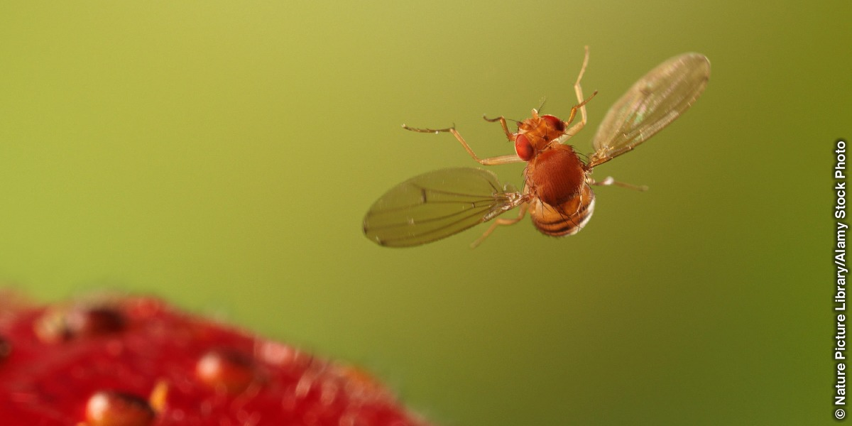
Thank you

Slide 79
Accepted male
Positive Information
Rejected male
Mate copying
Appetitive indirect learning
TH neurons
Aversive direct learning

Slide 80
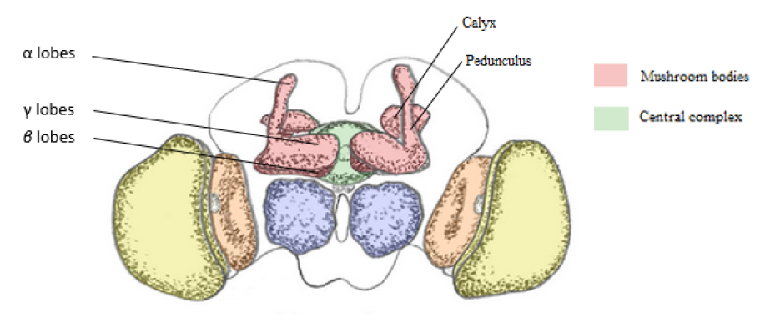
Supplementary 1

Slide 81
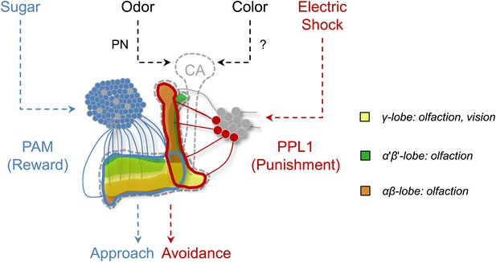
Supplementary 2
Ddc
TH

